Slide 1

A NodeMCU-based programmable
Reconfigurable Intelligent Surface for mm-Wave
5G Applications
www.gmrgroup.in

Slide 2
MAIN PROJECT
A Programmable and Reconfigurable Metasurface for MillimeterWave Applications
Presented By: Bhogyam Venkata Sai Koushik (20341A0420)
Inapakurthi Reshma (20341A0465)
Badampudi Vineetha (20341A0412)
Addanki Sindhuja (20341A0401)
Supervisor(s):
Dr. Yogesh Mishra Dr. B. Anil Babu
Professor, Sr.Asst Professor,
Dept of ECE, GMRIT Dept of ECE, GMRIT

Slide 3
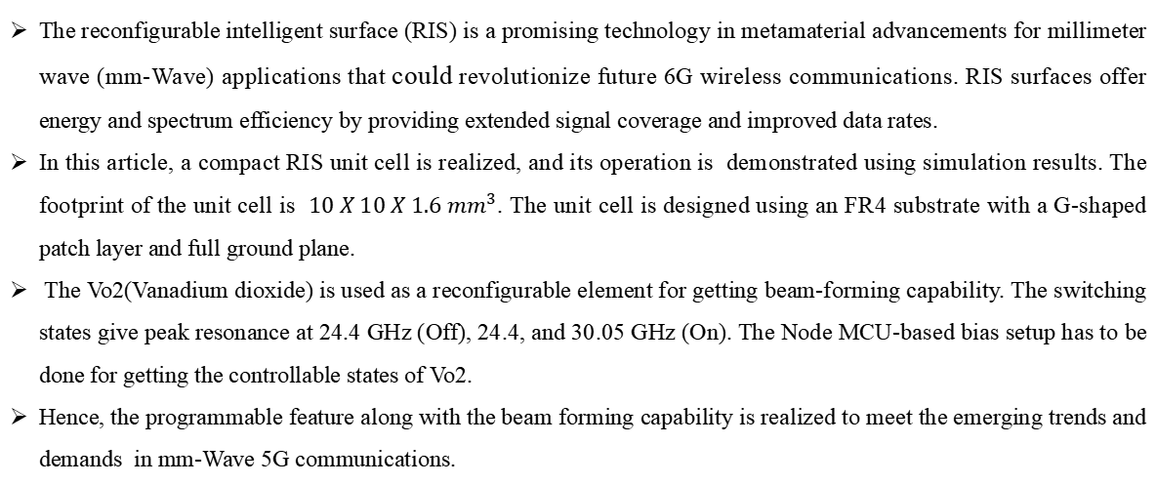
ABSTRACT
The reconfigurable intelligent surface (RIS) is a promising technology in metamaterial advancements for millimeter wave (mm-Wave) applications that could revolutionize future 6G wireless communications. RIS surfaces offer energy and spectrum efficiency by providing extended signal coverage and improved data rates.
In this article, a compact RIS unit cell is realized, and its operation is demonstrated using simulation results. The footprint of the unit cell is $10 X 10 X 1.6 {mm}^{3}$. The unit cell is designed using an FR4 substrate with a G-shaped patch layer and full ground plane.
The Vo2(Vanadium dioxide) is used as a reconfigurable element for getting beam-forming capability. The switching states give peak resonance at 24.4 GHz (Off), 24.4, and 30.05 GHz (On). The Node MCU-based bias setup has to be done for getting the controllable states of Vo2.
Hence, the programmable feature along with the beam forming capability is realized to meet the emerging trends and demands in mm-Wave 5G communications.

Slide 4
INTRODUCTION
RIS Reconfigurable Intelligent Surfaces offer versatile solutions for enhancing wireless communication systems, IoT networks, satellite communication, millimeter-wave communication, smart environments, and security applications.
Their ability to dynamically manipulate electromagnetic waves makes them valuable tools for optimizing connectivity, improving performance, and addressing emerging communication challenges.
Working Principle of Reconfigurable Intelligent Surface
Reconfigurable Intelligent Surfaces (RIS) is a cutting-edge technology that optimizes and controls the propagation of electromagnetic waves using the concepts of phase control, beamforming, and wavefront manipulation.
Gaining an understanding of these concepts is essential to understanding how RIS operates.
Reconfigurable Intelligent Surfaces revolve around the passive manipulation of electromagnetic waves through precise control of phase and amplitude adjustments of reflecting elements.
This enables advanced signal shaping, beamforming, and beam steering capabilities, ultimately enhancing wireless communication performance and adaptability.

Slide 5
INTRODUCTION
Phase Control
Phase control is one of the most important components of RIS functioning. An electromagnetic wave's position within a wave cycle is determined by its phase.
Real-time adjustable phase shifters are a feature of RIS elements. The phase of the reflected or scattered waves can be precisely controlled with the help of these phase shifters.
Beamforming
RIS makes use of beamforming, a crucial wireless communication technology, to enhance signal quality.
RIS can direct beams toward particular receivers or devices by varying the phase shifts of individual components, improving signal quality and strength at the intended destinations.
Beam Steering
Beam steering involves dynamically changing the direction of the focused beam without physically moving the transmitter or receiver.
This is achieved by adjusting the phase of elements in an array, effectively altering the directionality of the wavefront.

Slide 6
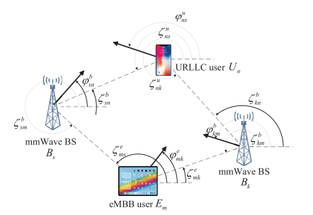
LITERATURE SURVEY
[1]R. Liu, G. Yu, J. Yuan, and G. Y. Li, “Resource management for millimeter-wave ultra-reliable and low-latency communications,” IEEE Trans. Commun., vol. 69, no. 2, pp. 1094–1108, Feb. 2021.
This project introduces a novel frequency-reconfigurable method using vanadium dioxide (VO2), a phase change material (PCM) capable of electrically switching between insulator and metal states.
The VO2 film is integrated into a uniplanar compact photonic-bandgap (UC-PBG) structure, forming a frequency-reconfigurable metasurface (FRMS) with a frequency ratio of 1.78.
Fig 1 : Communicative devices[1]

Slide 7
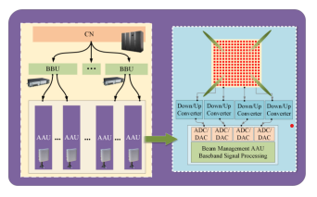
LITERATURE SURVEY
[2] W. Hong et al., “The role of millimeter-wave technologies in 5G/6G wireless communications,” IEEE J. Microw., vol. 1, no. 1, pp. 101–122, Jan. 2021.
The rapid evolution of wireless communication technology from the first-generation (1G) to the upcoming fifth-generation (5G) and anticipates the need for a sixth-generation (6G) beyond 2030.
The focus is on the promise of 5G, which offers ultra-fast data rates, low latency, and improved spectral efficiency, especially through the use of millimeter-wave spectrum in mobile communication infrastructures.
Fig 2: Evolution of technologies[2]

Slide 8
LITERATURE SURVEY
[3] Y. F. Cao, X. Y. Zhang, and Q. Xue, “Compact shared-aperture dual-band dual-polarized array using filtering slot antenna and dual-function metasurface,” IEEE Trans. Antennas Propag., vol. 70, no. 2, pp. 1120–1131, Feb. 2022.
In this work a shared-aperture dual-band dual-polarized antenna array designed for fifth-generation (5G) mobile communication.
The array utilizes a single radiating aperture that combines four higher band (HB) patch antenna elements with a lower band (LB) full-wavelength slot antenna.
The miniaturization of the array is achieved by bending the ground plane of the slot antenna.

Slide 9
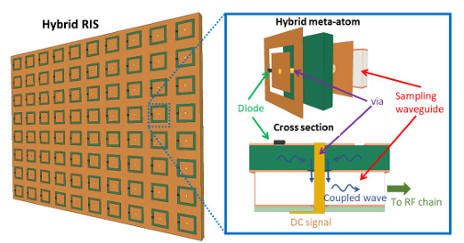
LITERATURE SURVEY
[4] G. C. Alexandropoulos, N. Shlezinger, I. Alamzadeh, M. F. Imani, H. Zhang and Y. C. Eldar, "Hybrid Reconfigurable Intelligent Metasurfaces: Enabling Simultaneous Tunable Reflections and Sensing for 6G Wireless Communications," in IEEE Vehicular Technology Magazine, doi: 10.1109/MVT.2023.3332580.
The latest discussions on the upcoming sixth Generation (6G) of wireless communications are envisioning future networks as a unified communications, sensing, and computing platform.
The recently conceived concept of the smart radio environment, enabled by Reconfigurable Intelligent Surfaces (RISs), contributes towards this vision offering programmable propagation of information-bearing signals.
Fig. 3: Illustration of the HRIS and the constitutive hybrid meta-atom design proposed in [41].

Slide 10
LITERATURE SURVEY
[5] Z. Wani, M. P. Abegaonkar and S. K. Koul, "Thin Planar Metasurface Lens for Millimeter-Wave MIMO Applications," in IEEE Transactions on Antennas and Propagation, vol. 70, no. 1, pp. 692-696, Jan. 2022, doi: 10.1109/TAP.2021.3098571.
28-GHz frequency band has emerged as potential candidates for next generation communication due to its low oxygen absorption rates unlike 60GHz.
The mmWave MIMO technique is going to be the promising candidate to deliver high data rates required for streaming 8K video content and virtual reality services.
Amillimeter-wave antenna consisting of four dipole antenna elements is proposed for MIMO applications at 28GHz band.
The four port antenna has pattern diversity in XY-plane with each antenna offering gain of 10dBi.

Slide 11
METHODOLOGY
Hardware Design of RISs
RIS is a technology that reflects and manipulates electromagnetic waves using a surface made up of many tiny, controlled unit cells.
RIS can improve the performance of wireless communication generally, minimize interference, and maximize signal transmission by modifying the characteristics of these unit cells.
Vanadium dioxide(VO2) is a semiconductor device used in high-frequency applications. Vanadium diodes act as "switches" that regulate the characteristics of the unit cells in the RIS.
The electrical properties of the unit cells can be modified by adjusting the bias voltage applied to these diodes.
Consequently, this enables you to control the amplitude and phase of reflected electromagnetic waves.

Slide 12
METHODOLOGY
Interfacing with NodeMCU board: Interfacing the RIS unit cell with an NodeMCU board by using a microcontroller for real-time control and operation of the RIS.
Comparison of work based on literature: To ensure the novelty and effectiveness of the design, comparing the approach and results with existing research is required.
Architecture Establishment:This involves moving from the design phase to the manufacturing and testing phase, ultimately leading to a functional RIS unit cell.
Modeling and simulation of RIS unit cell: This model simulates how the RIS unit cell interacts with electromagnetic waves, including reflection, refraction, and absorption.
Verification of existing design:This involves reviewing research papers, patents, and existing designs related to RIS technology.
Parametric Optimization: If no existing designs satisfy your specifications, there is a need to perform parametric optimization.

Slide 13
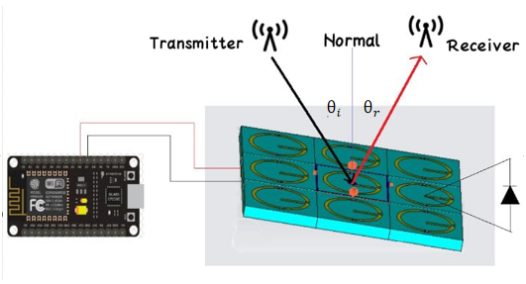
METHODOLOGY
Modeling and simulation of RIS unit cell: This model simulates how the RIS unit cell interacts with electromagnetic waves, including reflection, refraction, and absorption.
Verification of existing design:This involves reviewing research papers, patents, and existing designs related to RIS technology.
Parametric Optimization: If no existing designs satisfy your specifications, there is a need to perform parametric optimization.
Fabrication Accessibility: If the design meets the required specifications, then it's ready for the fabrication process.
Fig.4. Schematic view for characterization of
proposed RIS surface with NodeMCU

Slide 14
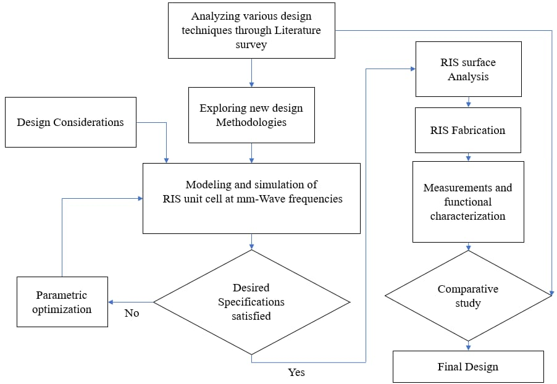
DESIGN FLOWCHART

Slide 15
BLOCK DIAGRAM
Transmitter
Reciever
Arduino/ESP32/
NodeMCU
Reconfigurable materials
Varactor diode/p-i-n diode/VO2
RIS Surface
Fig.5: Block Diagram

Slide 16
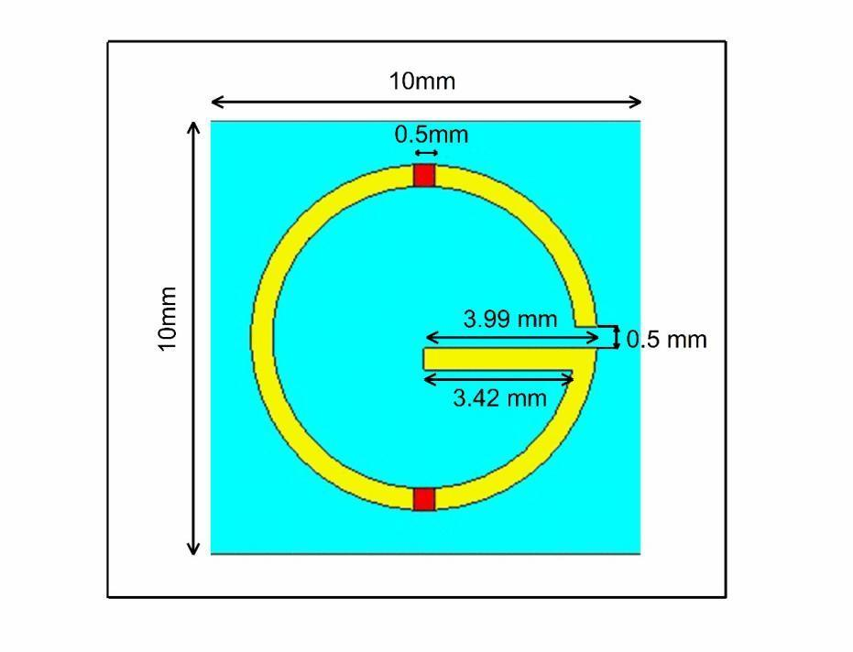
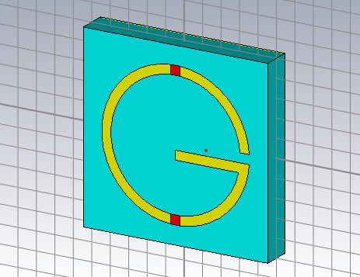
PROPOSED DESIGN
Unit cell: It is made up of three layers and the length must contain less than or equals to 10 mm.
The design is shown with exact dimensions as taken for the proposed model with an equivalent circuit in on and off conditions
Fig.6. geometry of RIS unit-cell

Slide 17
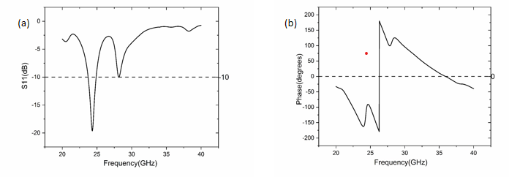
S-PARAMETER RESULTS FOR VO2
VO2 based reconfiguration results: These are the figures shown for the on state and off state results of the VO2
Fig.7. VO2 off s-parameters magnitude
Fig.8. VO2 off s-parameters phase

Slide 18
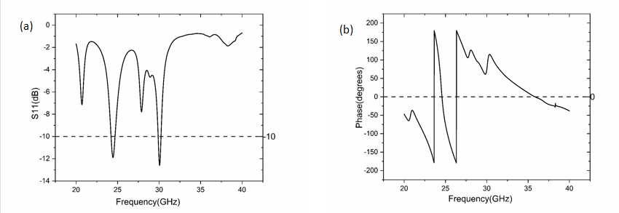
S-PARAMETER RESULTS FOR VO2
Fig.9. VO2 on s-parameters magnitude
Fig.10. VO2 on s-parameters phase

Slide 19
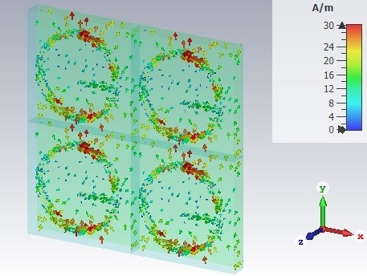
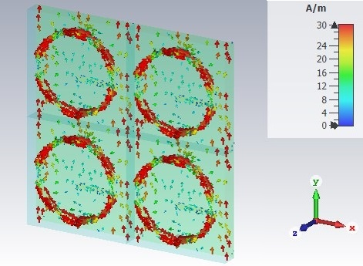
SURFACE CURRENT RESULTS FOR VO2
Surface current: These figures shows the difference between farfields of VO2 with various frequencies.
Fig.11. VO2 on surface current at f=24.435
Fig.12. VO2 on surface current at f=30.057

Slide 20
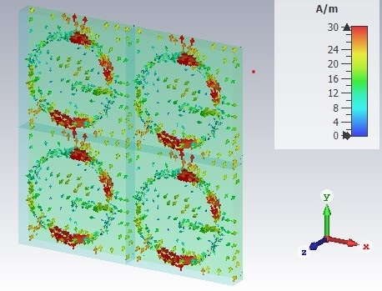
SURFACE CURRENT RESULTS FOR VO2
Fig.13. VO2 on surface current at f=24.364

Slide 21
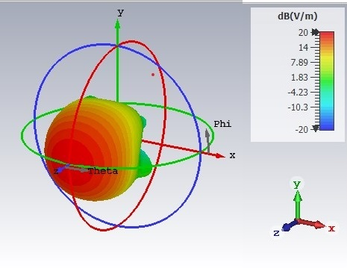
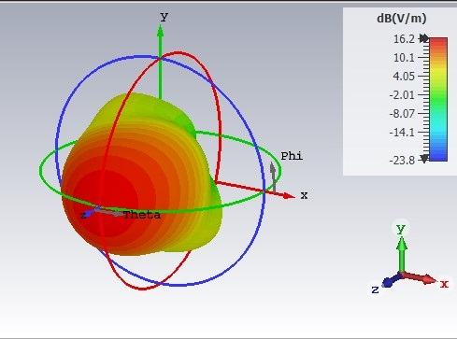
FAR FIELD RESULTS FOR VO2
Farfields: These figures shows the farfields of VO2 at different frequencies.
Fig.14. VO2 on Farfield at f=24.435
Fig.15. VO2 on surface current at f=30.057

Slide 22
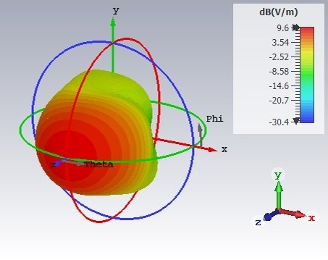
FAR FIELD RESULTS FOR VO2
Fig.16. VO2 on Farfield at f=24.364

Slide 23
FABRICATION PROTOTYPE
Fig.17. Bias setup of NodeMCU
Here, NodeMCU programmable board is used for switching on and off of the metasurface by supplying the power of 5v for on state and 0v for off state.
This operation is done by a software code that is dumped into NodeMCU.

Slide 24
COMPARISION TABLE
Reference | Unit Cell size/substrate | Frequency(GHz) | Reconfigurable element | Application | Programmable device
[34] | 3.3 X 3.3/Silicon | 27.5-31 | VO2 | Transmission | Micro heaters
[35] | 0.5 X 0.5/sapphire | 20 | VO2 | Transmission | No programmable device
[36] | 960 X 462/Silicon | 2 - 18 | P-I-N | Beam Steering | Genetic Algorithm
[37] | 3.85 X 3.85/Silicon | 27.5 | P-I-N | Bandwidth | No programmable device
[38] | 5.34 X 5.34/RO4350B | 30.6 - 31.7 | Varactor diode | Beam steering | Bias Voltage
[39] | 3X3/RO3003 | 22.7 - 25.6 | Varactor diode | Bandwidth | No programmable device
[40] | 10X10/FR-4 | 32.5 - 34 | AlGaAs | Beamforming | Bias voltage/Arduino
Proposed | 10 X 10/FR-4 | 24 - 31 | VO2 | Beamforming | Bias voltage/NodeMCU

Slide 25
CONCLUSION
In this project, We have designed a NodeMCU- Controlled mm Wave RIS unit cell that has beamforming ability and angular stability for mm-wave communications.
The model is designed using a VO2 diode that is perfect for mmWave frequencies and it resonates at 24.364,24.435 and 30.057GHz frequencies. These properties are studied using CST simulation results. The overall model is modified into a programmable RIS by giving NodeMCU control.
The methodology and design characteristics were also studied. Hence, the design of the NodeMCU-controlled RIS surface has the capacity to meet the needs of 5G mmWave applications.

Slide 26

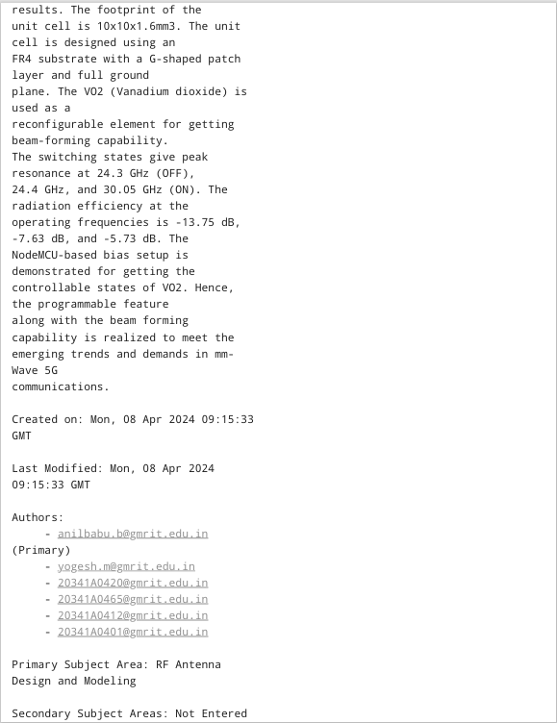

JOURNAL PUBLICATION STATUS

Slide 27
REFERNCES
[1] W. Tang et al., "Path Loss Modeling and Measurements for Reconfigurable Intelligent Surfaces in the Millimeter-Wave Frequency Band," in IEEE Transactions on Communications, vol. 70, no. 9, pp. 6259-6276, Sept. 2022, doi: 10.1109/TCOMM.2022.3193400.
[2] S. Pan, D. Zhai, Y. Feng, L. Qi and G. Li, "Design of a Waveguide-fed Dynamic Reconfigurable Metasurface Element," 2020 International Conference on Microwave and Millimeter Wave Technology (ICMMT), Shanghai, China, 2020, pp. 1-3, doi: 10.1109/ICMMT49418.2020.9386693.
[3] J. A. Hodge, T. G. Spence and A. I. Zaghloul, "A Reconfigurable Intelligent Surface Using a 2-Bit Programmable Metasurface for Communications," 2021 IEEE International Symposium on Antennas and Propagation and USNC-URSI Radio Science Meeting (APS/URSI), Singapore, Singapore, 2021, pp. 97-98, doi: 10.1109/APS/URSI47566.2021.9703874.
[4] G. C. Alexandropoulos, N. Shlezinger, I. Alamzadeh, M. F. Imani, H. Zhang and Y. C. Eldar, "Hybrid Reconfigurable Intelligent Metasurfaces: Enabling Simultaneous Tunable Reflections and Sensing for 6G Wireless Communications," in IEEE Vehicular Technology Magazine, doi: 10.1109/MVT.2023.3332580.
[5] Z. Wani, M. P. Abegaonkar and S. K. Koul, "Thin Planar Metasurface Lens for Millimeter-Wave MIMO Applications," in IEEE Transactions on Antennas and Propagation, vol. 70, no. 1, pp. 692-696, Jan. 2022, doi: 10.1109/TAP.2021.3098571.

Slide 28
REFERNCES
[6] J. -B. Gros, V. Popov, M. A. Odit, V. Lenets and G. Lerosey, "A Reconfigurable Intelligent Surface at mmWave Based on a Binary Phase Tunable Metasurface," in IEEE Open Journal of the Communications Society, vol. 2, pp. 1055-1064, 2021, doi: 10.1109/OJCOMS.2021.3076271.
[7] R. Liu, M. Li, H. Luo, Q. Liu and A. L. Swindlehurst, "Integrated Sensing and Communication with Reconfigurable Intelligent Surfaces: Opportunities, Applications, and Future Directions," in IEEE Wireless Communications, vol. 30, no. 1, pp. 50-57, February 2023, doi: 10.1109/MWC.002.2200206.
[8] Channel Estimation for Reconfigurable Intelligent Surface Aided Multi User mmWaveMIMOSystems
[9] Y. Liu et al., "Reconfigurable Intelligent Surfaces: Principles and Opportunities," in IEEE Communications Surveys & Tutorials, vol. 23, no. 3, pp. 1546-1577, third quarter 2021, doi: 10.1109/COMST.2021.3077737.
[10] J. Han, L. Li, S. Tian, G. Liu, H. Liu and Y. Shi, "Millimeter-Wave Imaging Using 1-Bit Programmable Metasurface: Simulation Model, Design, and Experiment," in IEEE Journal on Emerging and Selected Topics in Circuits and Systems, vol. 10, no. 1, pp. 52-61, March 2020, doi: 10.1109/JETCAS.2020.2973466

Slide 29
REFERNCES
[11] W. Yang, C. Zhou, Q. Xue, Q. Wen and W. Che, "Millimeter-Wave Frequency-Reconfigurable Metasurface Antenna Based on Vanadium Dioxide Films," in IEEE Transactions on Antennas and Propagation, vol. 69, no. 8, pp. 4359-4369, Aug. 2021, doi: 10.1109/TAP.2020.3048551.
[12] RIS for energy efficiency in Wireless Communication (2019)-2571
[13] Smart radio environmentsempoweredbyRIS-howitworks,state of research and the road ahead(2020)- 1854-
[14] Meta-materials and their application in the performance enhancement of reconfigurable antennas(2023)-24
[15] X. Pei et al., "RIS-Aided Wireless Communications: Prototyping, Adaptive Beamforming, and Indoor/Outdoor Field Trials," in IEEE Transactions on Communications, vol. 69, no. 12, pp. 8627-8640, Dec. 2021, doi: 10.1109/TCOMM.2021.3116151.
[16] G. C. Alexandropoulos, N. Shlezinger and P. del Hougne, "Reconfigurable Intelligent Surfaces for Rich Scattering Wireless Communications: Recent Experiments, Challenges, and Opportunities," in IEEE Communications Magazine, vol. 59, no. 6, pp. 28-34, June 2021, doi: 10.1109/MCOM.001.2001117.

Slide 30
REFERNCES
[17] K. Keykhosravi et al., "Leveraging RIS-Enabled Smart Signal Propagation for Solving Infeasible Localization Problems: Scenarios, Key Research Directions, and Open Challenges," in IEEE Vehicular Technology Magazine, vol. 18, no. 2, pp. 20-28, June 2023, doi: 10.1109/MVT.2023.3237004.
[18] M. Ahmed et al., "A Survey on STAR-RIS: Use Cases, Recent Advances, and Future Research Challenges," in IEEE Internet of Things Journal, vol. 10, no. 16, pp. 14689-14711, 15 Aug.15, 2023, doi: 10.1109/JIOT.2023.3279357.
[19] G. C. Alexandropoulos, N. Shlezinger, I. Alamzadeh, M. F. Imani, H. Zhang and Y. C. Eldar, "Hybrid Reconfigurable Intelligent Metasurfaces: Enabling Simultaneous Tunable Reflections and Sensing for 6G Wireless Communications," in IEEE Vehicular Technology Magazine, doi: 10.1109/MVT.2023.3332580.
[20] Electrically driven reprogrammable phase-change metasurface reaching 80% efficiency
[21] S. Zeng, H. Zhang, B. Di, Z. Han and L. Song, "Reconfigurable Intelligent Surface (RIS) Assisted Wireless Coverage Extension: RIS Orientation and Location Optimization," in IEEE Communications Letters, vol. 25, no. 1, pp. 269-273, Jan. 2021,doi: 10.1109/LCOMM.2020.3025345.
[22] L. Dai et al., "Reconfigurable Intelligent Surface-Based Wireless Communications:Antenna Design, Prototyping, and Experimental Results," in IEEE Access, vol. 8, pp.45913-45923, 2020, doi: 10.1109/ACCESS.2020.2977772.

Slide 31
REFERNCES
[23] W. Tang et al., "Wireless Communications With Reconfigurable Intelligent Surface:Path Loss Modeling and Experimental Measurement," in IEEE Transactions on Wireless Communications, vol. 20, no. 1, pp. 421-439, Jan. 2021, doi:10.1109/TWC.2020.30248
[24] A. Araghi et al., "Reconfigurable Intelligent Surface (RIS) in the Sub-6 GHz Band: Design, Implementation, and Real-World Demonstration," in IEEE Access, vol. 10, pp. 2646-2655, 2022, doi: 10.1109/ACCESS.2022.3140278.
[25] C. Pan et al., "An Overview of Signal Processing Techniques for RIS/IRS-Aided Wireless Systems," in IEEE Journal of Selected Topics in Signal Processing, vol. 16, no. 5, pp. 883-917, Aug. 2022, doi: 10.1109/JSTSP.2022.3195671.
[26] M. M. Amri, "Recent Trends in the Reconfigurable Intelligent Surfaces (RIS): Active RIS to Brain-controlled RIS," 2022 IEEE International Conference on Communication, Networks and Satellite (COMNETSAT), Solo, Indonesia, 2022, pp. 299-304, doi: 10.1109/COMNETSAT56033.2022.9994338.
[27] F. Ahmed et al., "A Multi-Bit and Frequency-Reconfigurable Reflecting Surface for RIS Applications," in IEEE Antennas and Wireless Propagation Letters, doi: 10.1109/LAWP.2023.3331608.

Slide 32
REFERNCES
[28] A. Sayanskiy et al., "A 2D-Programmable and Scalable Reconfigurable Intelligent Surface Remotely Controlled via Digital Infrared Code," in IEEE Transactions on Antennas and Propagation, vol. 71, no. 1, pp. 570-580, Jan. 2023, doi: 10.1109/TAP.2022.3217327
[29] Z. -Y. Wu, M. Ismail and J. Wang, "Efficient Allocation of Intelligent Surfaces in Programmable Wireless Environments," ICC 2021 - IEEE International Conference on Communications, Montreal, QC, Canada, 2021, pp. 1-6, doi: 10.1109/ICC42927.2021.9500834
[30] T. N. Do, G. Kaddoum, T. L. Nguyen, D. B. da Costa and Z. J. Haas, "Multi-RIS-Aided Wireless Systems: Statistical Characterization and Performance Analysis," in IEEE Transactions on Communications, vol. 69, no. 12, pp. 8641-8658, Dec. 2021, doi: 10.1109/TCOMM.2021.3117599.
[31] G. C. Alexandropoulos and E. Vlachos, "A Hardware Architecture For Reconfigurable Intelligent Surfaces with Minimal Active Elements for Explicit Channel Estimation," ICASSP 2020 - 2020 IEEE International Conference on Acoustics, Speech and Signal Processing (ICASSP), Barcelona, Spain, 2020, pp. 9175-9179, doi: 10.1109/ICASSP40776.2020.9053976.
[32] A. Pitilakis et al., "Reconfigurable Metasurface Architecture for Complete Wavefront Control in mmWave Programmable Wireless Environments," 2023 Seventeenth International Congress on Artificial Materials for Novel Wave Phenomena (Metamaterials), Chania, Greece, 2023, pp. X-267-X-269, doi: 10.1109/Metamaterials58257.2023.10289258

Slide 33
REFERNCES
[33] S. Hua, Y. Zhou, K. Yang, Y. Shi and K. Wang, "Reconfigurable Intelligent Surface for Green Edge Inference," in IEEE Transactions on Green Communications and Networking, vol. 5, no. 2, pp. 964-979, June 2021, doi: 10.1109/TGCN.2021.3058657.
[34] M. S. Lust, D. L. West, V. Smet, T. G. Williamson and N. Ghalichechian, "Vanadium Dioxide-Based Reconfigurable Ka-Band Dual-Sense Linear-to-Circular Polarizer," in IEEE Transactions on Antennas and Propagation, doi: 10.1109/TAP.2024.3356615.
[35] Ma, Y. L., W. P. Wan, Z. B. Wang, Q. Chen, Y. J. Zheng, T. T. Guo, C. Y. Shuai, and Y. Q. Fu. "Broadband phase-modulated metasurface based on vanadium dioxide patches in microwave band." AIP Advances 13, no. 4 (2023).
[36] H. Xue et al., "A Reconfigurable Metasurface Enhancing Signal Coverage for Wireless Communication Using Reduced Numbers of p-i-n Diodes," in IEEE Transactions on Microwave Theory and Techniques, doi: 10.1109/TMTT.2023.3311952
[37] R. Wang, Y. Yang, B. Makki and A. Shamim, "A Wideband Reconfigurable Intelligent Surface for 5G Millimeter-Wave Applications," in IEEE Transactions on Antennas and Propagation, doi: 10.1109/TAP.2024.3352828

Slide 34
REFERNCES
[38] Wolff, Alexander, Lars Franke, Steffen Klingel, Janis Krieger, Lukas Mueller, Ralf Stemler, and Marco Rahm. "Continuous beam steering with a varactor-based reconfigurable intelligent surface in the Ka-band at 31 GHz." Journal of Applied Physics 134, no. 11 (2023).
[39] da Silva, Luis G., Zheng Chu, Pei Xiao, and Arismar Cerqueira S Jr. "A Varactor-based 1024-element RIS Design for mm-waves." Frontiers in communications and networks 4 (2023).
[40] Babu, Badisa Anil, Pulletikurthi Ram Kalyan, Varanasi Venkata Lakhmi, Rana Reharika, and Nakka Varun Raj. "An arduino-controlled reconfigurable intelligent surface with angular stability for 5G mmWave applications." Progress In Electromagnetics Research Letters 114 (2023): 69-74.
[41] I. Alamzadeh, G. C. Alexandropoulos, N. Shlezinger, , and M. F. Imani, “A reconfigurable intelligent surface with integrated sensing capability,” Scientific Reports, vol. 11, no. 1, pp. 1–10, 2021.

